Slide 1




COMMUNITY REPORT BACK
Arabic Speaking Community
RCP

Slide 2
01.
WHAT’S CRHE?
02.
WHAT WE DID
03.
WHAT WE LEARNED
04.
WHAT’S NEXT?
TABLE OF
CONTENT

Slide 3
01.
WHAT’S CRHE?
RCP Community Research

Slide 4

Website: https://academyhealth.org/node/20257

Slide 5
02.
WHAT WE DID
RCP Research Team

Slide 6
INDIVIDUAL INTERVIEWS
We conducted 15 individual interviews speaking Spanish, Burmese, Karen, Kinyarwanda, Pashto, Dari, and Arabic
LN SURVEYS
COMMUNITY HEALTH FORUMS
We analyzed 1200 Language Navigator post-appointment surveys
POLICY REVIEWS
We conducted 4 community health forums with Spanish, Arabic, Karen, and Burmese Speaking Women
We reviewed language access policies from Duke, UNC, the state, and federal government
Notes:
The project includes data form Language Navigator surveys, semi-structured interviews, community health forums, and reviews of institutional policies around language services.

Slide 7
03.
WHAT WE LEARNED
RCP Research Team

Slide 8
ARABIC COMMUNITY
ACCESS TO HEALTHCARE
HOSPITAL SYSTEMS
1. Providers need to be respectful of gender preferences
2. Navigating physical environments without language support is challenging
Navigating physical environments without language support is challenging
Insurance, charity care, and other forms of financial assistance do not make sense
INTERPRETATION SERVICES
ORAL HEALTH
1. Interpretation is rarely provided when the doctor is NOT present (check-in, labs, medical tests)
2. Accessing friendly, culturally competent, and linguistically competent interpretation is not guaranteed
3. Dialects and accents contribute to confusion or miscommunication in interpretation
4. Without accurate interpretation, understanding of healthcare knowledge is delayed and causes stress and confusion
5.
1. Accessing the dentist is difficult because it is expensive, there is a lack of dentists that accept medicare/medicaid, long wait time for appointments, and services needed are not included insurance
2. There is one dentist in Durham who speaks Arabic, but most dentists do not provide interpretation

Slide 9
RECOMMENDATIONS
Being friendly goes a long way in making non-english speaking patients feel safe and welcomed
Make Check-In kiosks more accessible by providing interpretation or translation
3. Honor patient’s preferences for gender of interpreter
4. Prepare for interpretation ahead of time so that patients don’t have to wait
5. Appointment reminders and all other communication should be done with interpretation or translation
6. Honor interpretation modality preference
7. To ensure continuity of care, have interpretation provided for all communications with patients
8. When referring people, ensure that the referral is within the same city, and accessible via bus
9. Make charity care decisions more transparent
10. Reduce the amount of time in between appointments
11. Check to ensure that the correct language is available
Notes:
The project includes data form Language Navigator surveys, semi-structured interviews, community health forums, and reviews of institutional policies around language services.

Slide 10
04.
WHAT’S NEXT?
RCP Research Team

Slide 11
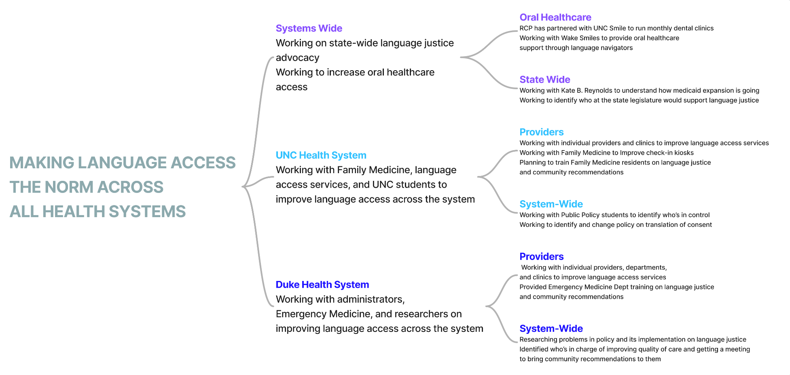

Slide 12
THANK YOU

