Slide 1




COMMUNITY REPORT BACK
Congolese Community - Swahili
RCP

Slide 2
01.
WHAT’S CRHE?
02.
WHAT WE DID
03.
WHAT WE LEARNED
04.
WHAT’S NEXT?
TABLE OF
CONTENT

Slide 3
01.
WHAT’S CRHE?
RCP Community Research

Slide 4
RCP’S CRHE PROJECT
01
Report out what we learned to improve access to interpretation and healthcare
Community-based
research to understand language in-access for LEP patients in healthcare in the Triangle, to develop recommendations for healthcare providers and systems, to reduce health inequity for all
Design research study with communities
03
02
Conduct research, analyze data

Slide 5
02.
WHAT WE DID
RCP Research Team

Slide 6
INDIVIDUAL INTERVIEWS
We conducted 15 individual interviews speaking Spanish, Burmese, Karen, Kinyarwanda, Pashto, Dari, and Arabic
LN SURVEYS
COMMUNITY HEALTH FORUMS
We analyzed 1200 Language Navigator post-appointment surveys
POLICY REVIEWS
We conducted 4 community health forums with Spanish, Arabic, Karen, and Burmese Speaking Women
We reviewed language access policies from Duke, UNC, the state, and federal government
Notes:
The project includes data form Language Navigator surveys, semi-structured interviews, community health forums, and reviews of institutional policies around language services.

Slide 7
03.
WHAT WE LEARNED
RCP Research Team

Slide 8
CONGOLESE COMMUNITY
INTERPRETATION SERVICES
HOSPITAL SYSTEMS
1. Interpretation is rarely provided when the doctor is NOT present (check-in, labs, medical tests)
2. Even when the doctor tries to get interpretation, it is very difficult to receive high quality interpretation
3. Without accurate interpretation, understanding of medical diagnoses and treatment plans is delayed and causes stress and confusion
4. Receiving interpretation in Kinyarawandan isn’t guaranteed, and sometimes people will have to ask for interpretation in a 2nd language (Swahili)
5. Interpretation is critical to quality healthcare and makes people feel more comfortable with service provision
6. Accessing friendly, culturally competent, and linguistically competent interpretation is not guaranteed
Navigating physical environments without language support is challenging
Insurance, charity care, and other forms of financial assistance do not make sense
ACCESS TO HEALTHCARE
1. Knowledge of where to go for acute healthcare needs is not explained well upon arrival
2. Healthcare providers need to be able to identify when interpretation is going poorly so that they can address it

Slide 9
RECOMMENDATIONS
Being friendly goes a long way in making non-english speaking patients feel safe and welcomed
Make Check-In kiosks more accessible by providing interpretation or translation
3. Honor patient’s preferences for gender of interpreter
4. Prepare for interpretation ahead of time so that patients don’t have to wait
5. Appointment reminders and all other communication should be done with interpretation or translation
6. Honor interpretation modality preference
7. To ensure continuity of care, have interpretation provided for all communications with patients
8. When referring people, ensure that the referral is within the same city, and accessible via bus
9. Make charity care decisions more transparent
10. Reduce the amount of time in between appointments
11. Check to ensure that the correct language is available
Notes:
The project includes data form Language Navigator surveys, semi-structured interviews, community health forums, and reviews of institutional policies around language services.

Slide 10
04.
WHAT’S NEXT?
RCP Research Team

Slide 11
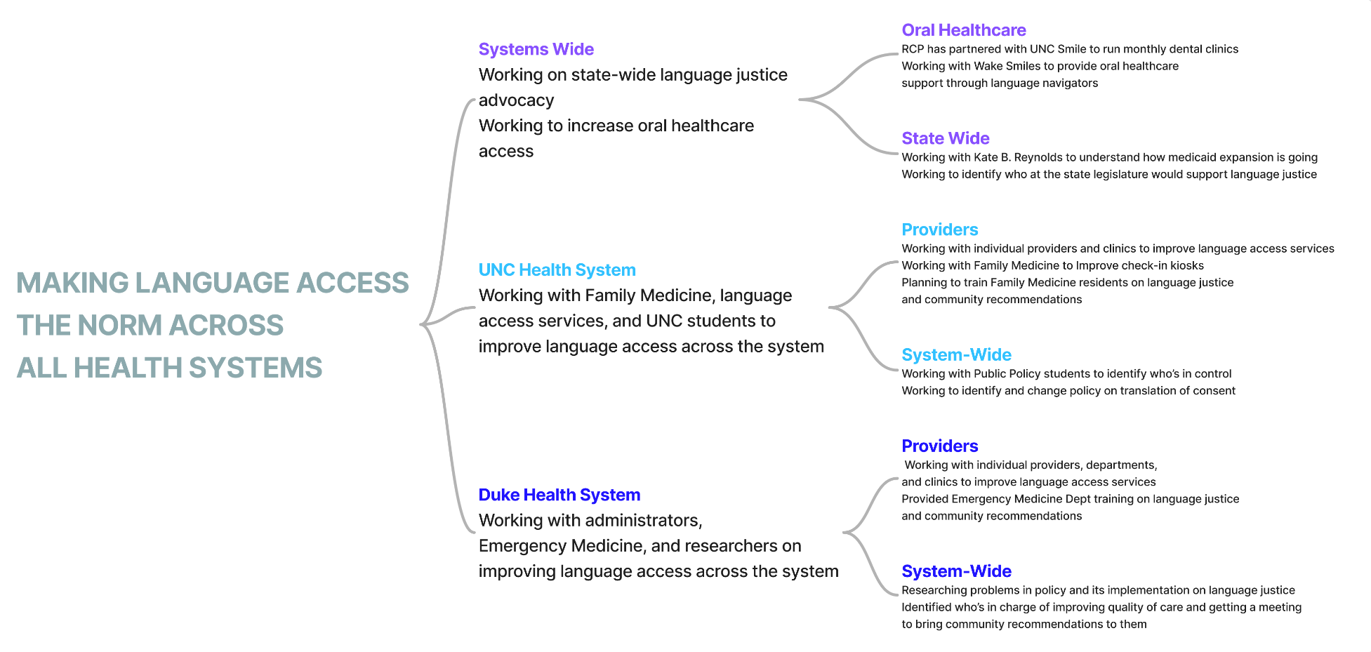

Slide 12
THANK YOU

